Slide 1
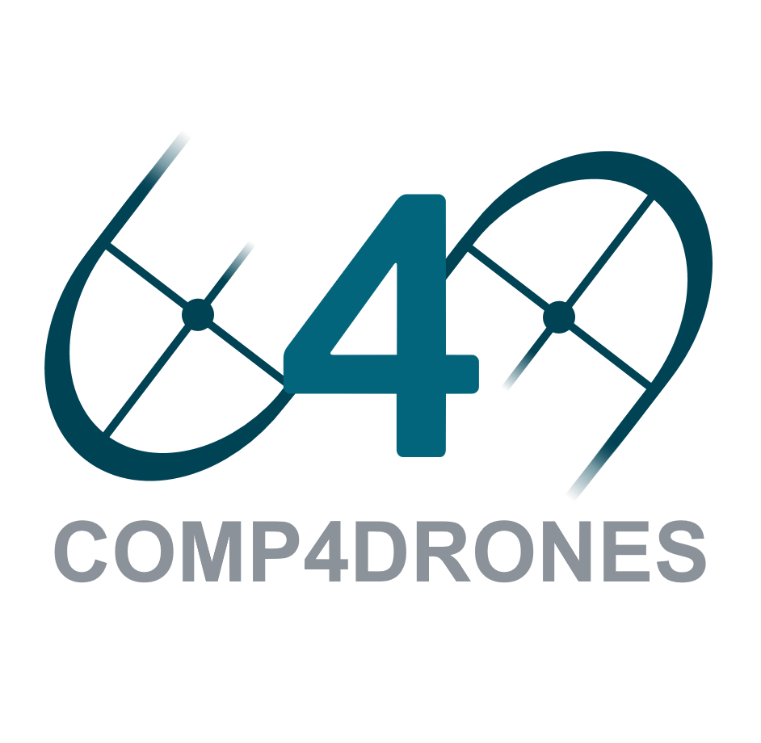

Slide 2
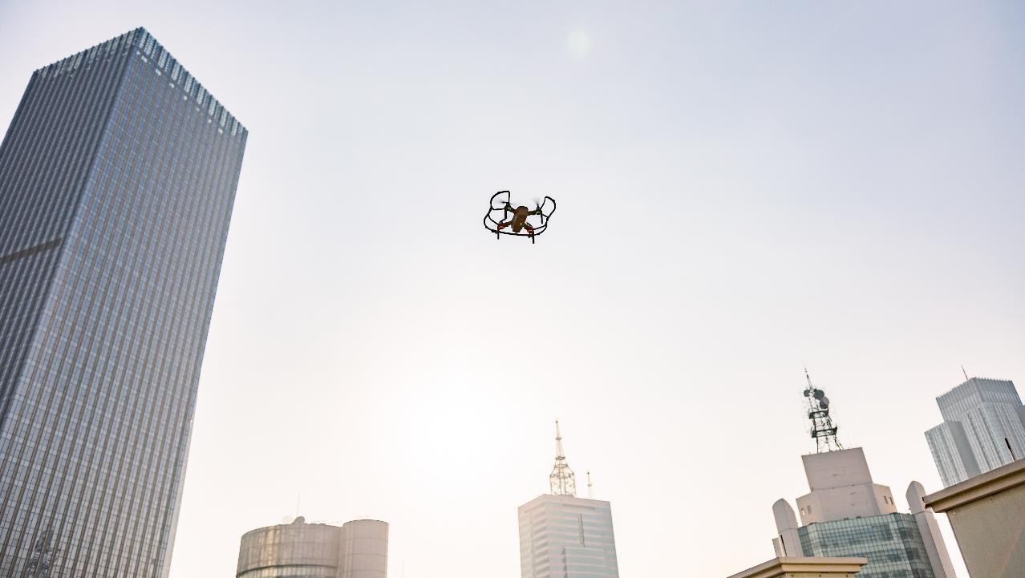
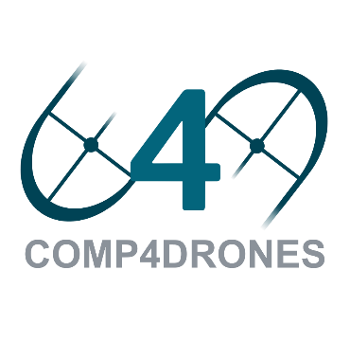
COMP4DRONES will provide a framework of key enabling technologies for safe and autonomous drones that will leverage their customization and modularity for civilian services

Slide 3
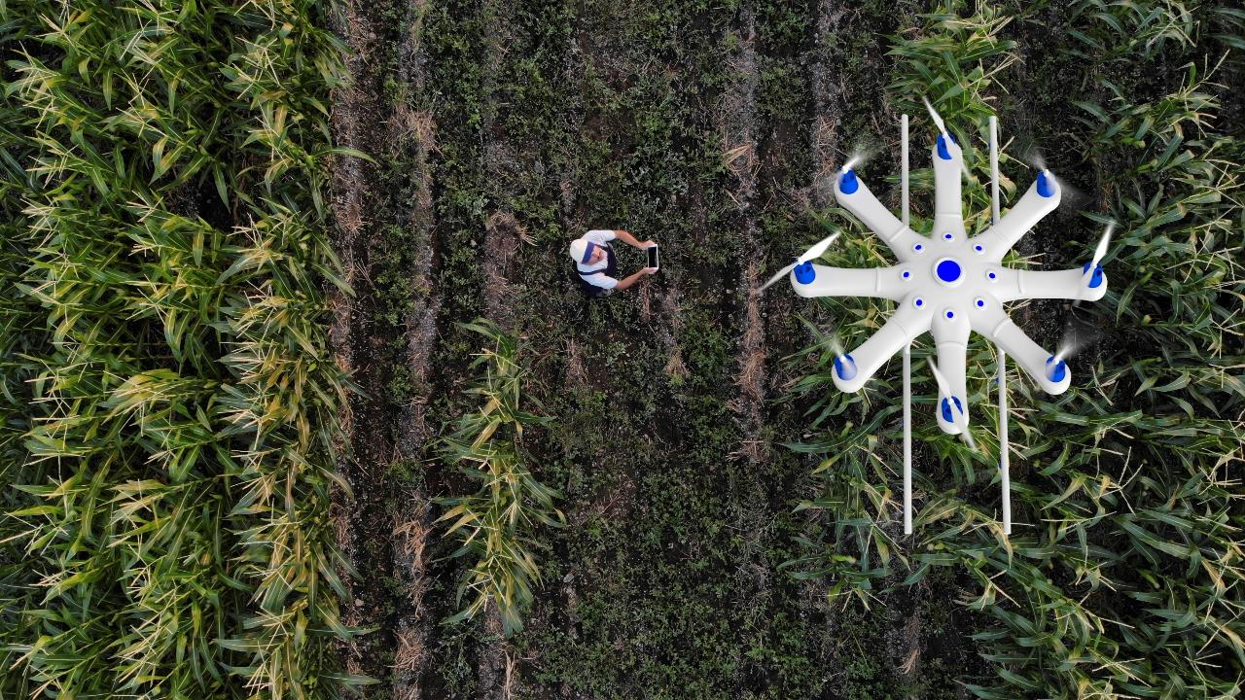
October 2019
September 2022
50
Project
Coordinator
Technical
Coordinator
Partners
29.76M€
Budget

Slide 4
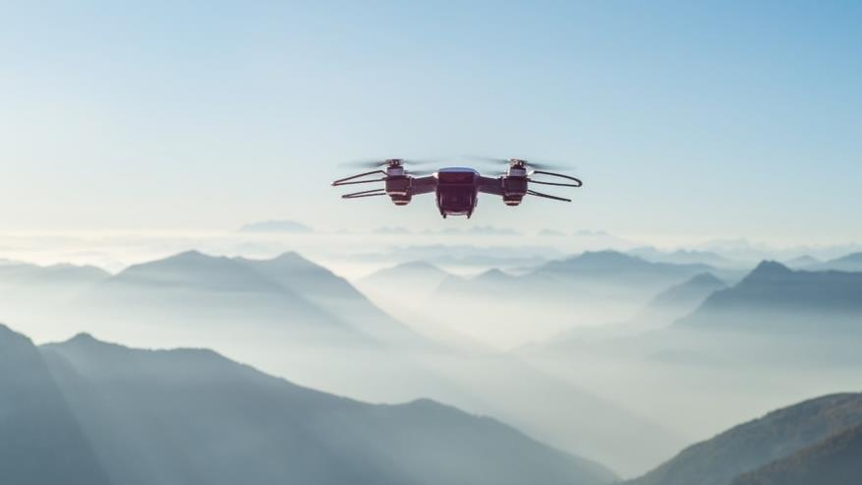
Project Objectives
Easing the integration and customization of drone embedded system
Enabling drones to take safe autonomous decisions
Ensure the deployment of trusted
communications
Minimizing the design and verification efforts for complex drone applications
Ensuring sustainable impact and creation of an industry-driven community

Slide 5
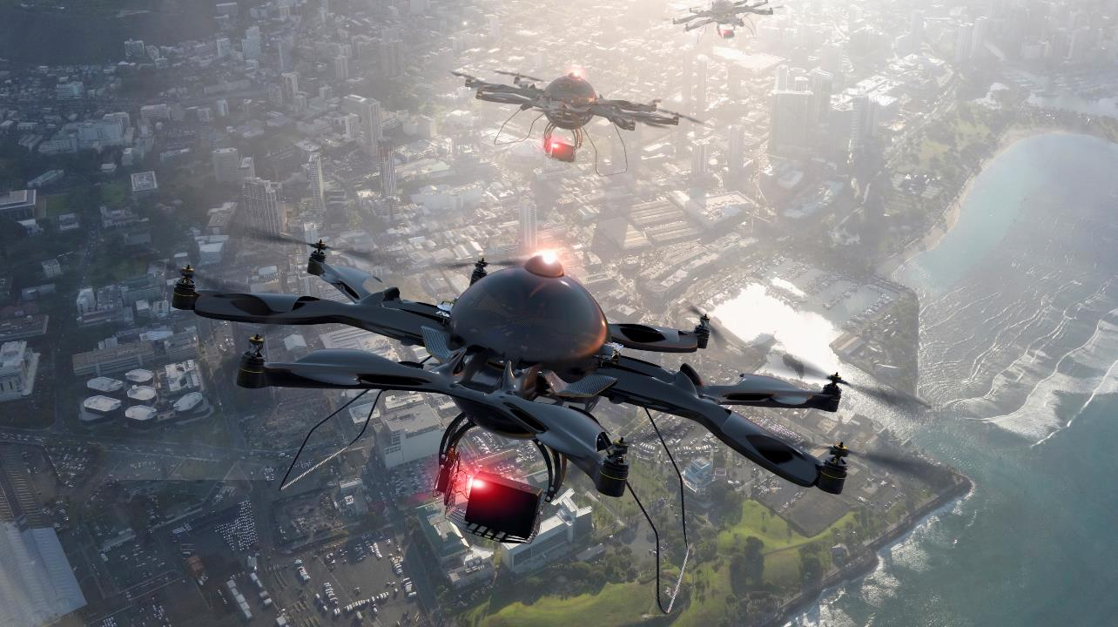
Safe and Autonomous
Smart navigation systems and sensory fusion technologies for real-time applications will be developed, such as visual object recognition, attention, and multi-sensory integration.
Trusted Communications
Development of trusted communications dealing with the identification of cyber-security threats, their risk and scope evaluation and the deployment of the decision and/or actions to mitigate or protect against those attacks.

Slide 6
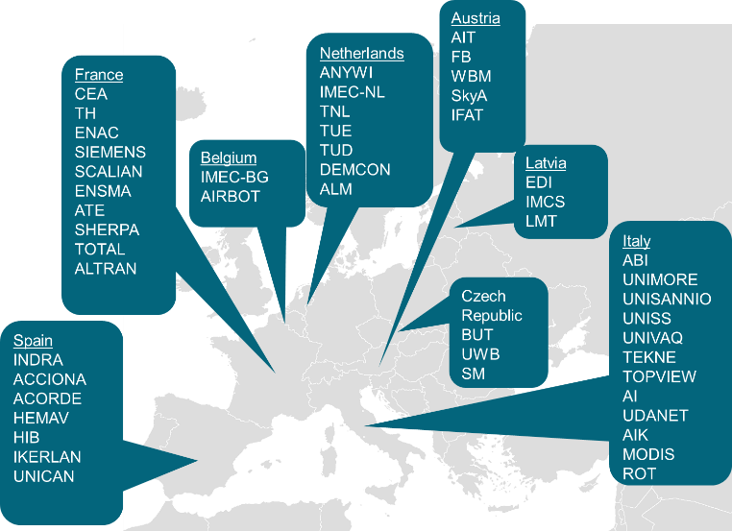
Consortium

Slide 7
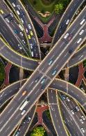
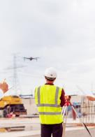
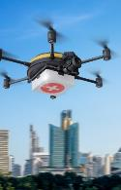
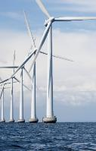
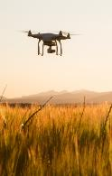
Five relevant societal use cases
Transport
Construction
Logistics
Surveillance & Inspection
Agriculture
Drones for optimization of transport control, operation and infrastructure management
Drones for virtual design, construction and operation of transport infrastructures
Logistics using heterogeneous drone fleets
Drone and wheeled robotic systems for inspection, surveillance and rescue operations
Smart precision agriculture: from drone to rover
AIT
FB
IFAT
SKYA
WBM
TOTAL
ALTRAN
ATE
ENSMA
SCALIAN
SHERPA
SIEMENS
SOBEN
ENAC
ABI
AI
AIK
ROT
TEKNE
UDANET
UNIMORE
UNISANNIO
UNISS
UNIVAQ
IMCS
LMT
INDRA
ACCIONA
HIB
ACORDE
UNICAN
INDRA-PROINTEC
TNL
ANYWI
DEMCOM
IMEC-NL
TUD
TUE
IMEC-BG
AIROBOT
ALM
BUT
SM

Slide 8
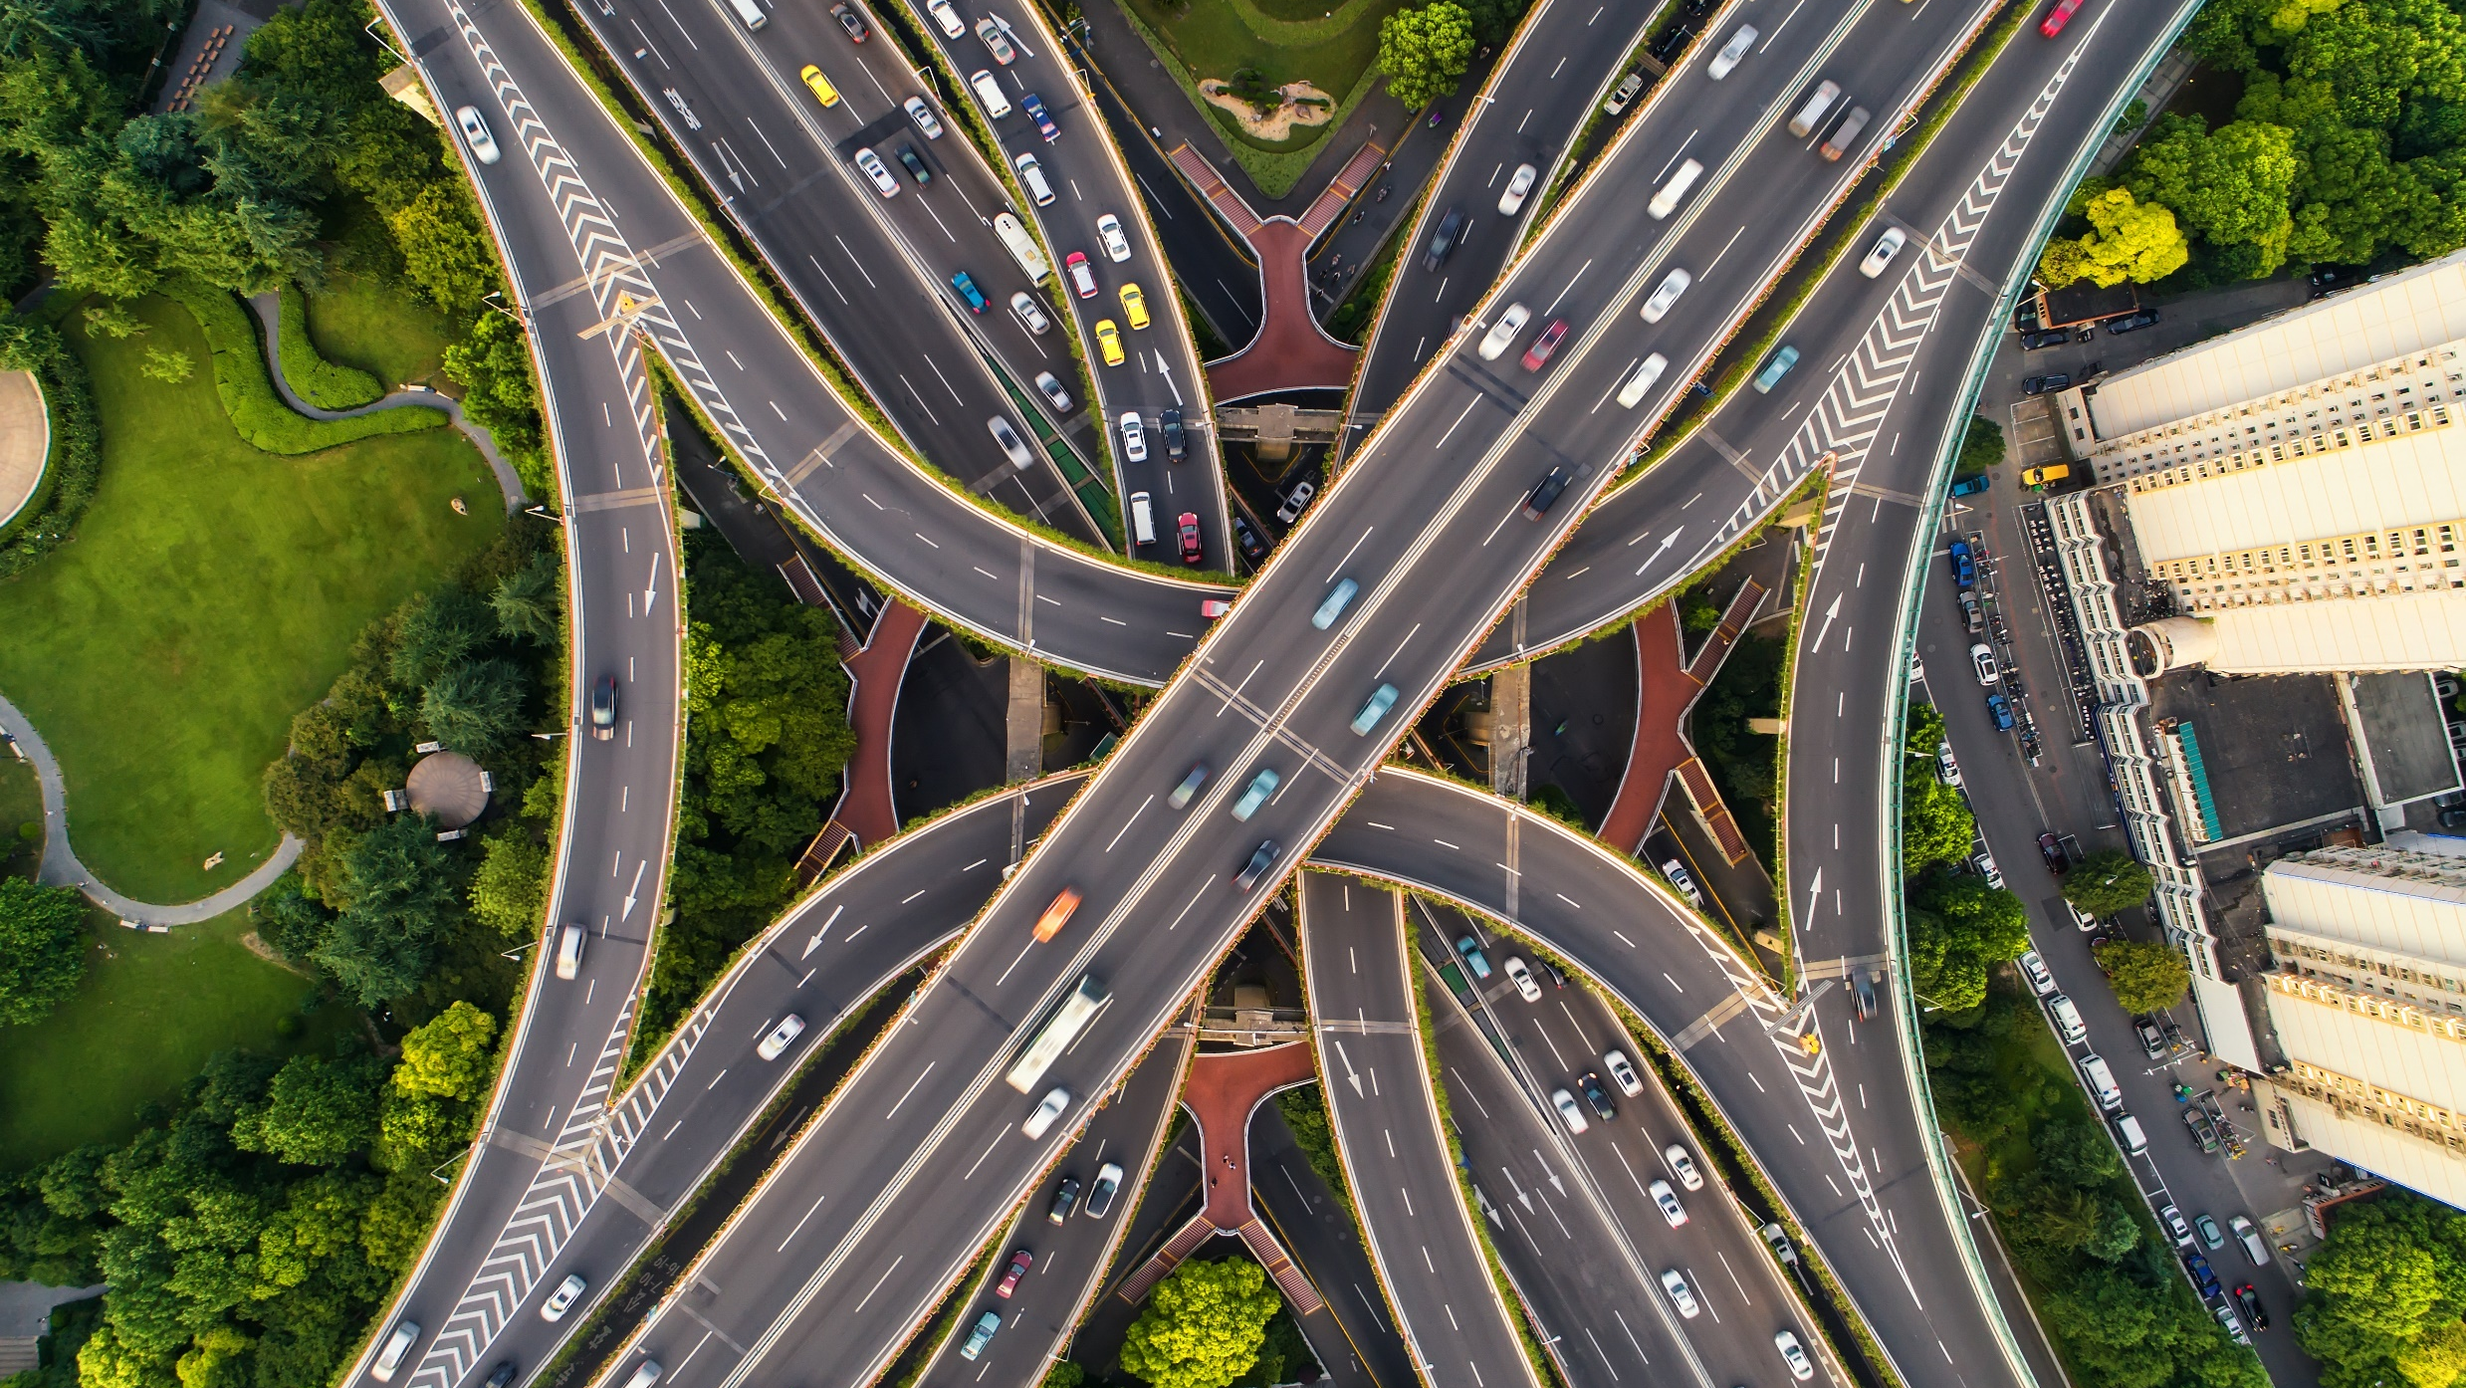
Transport
In this Use Case the drones will be used as novel monitoring devices for the road traffic and infrastructure conditions, enabling a faster detection and early response to incidents.

Slide 9
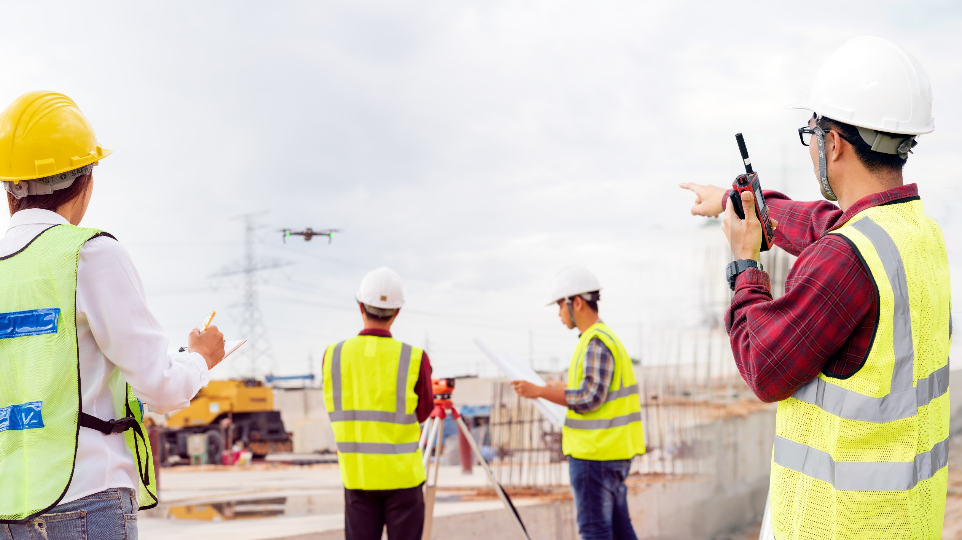
Construction
This Use Case aims to develop the technology required to carry out any type of operation that allows the Digitalization of the State of the Constructive Process of a Civil Infrastructure.

Slide 10
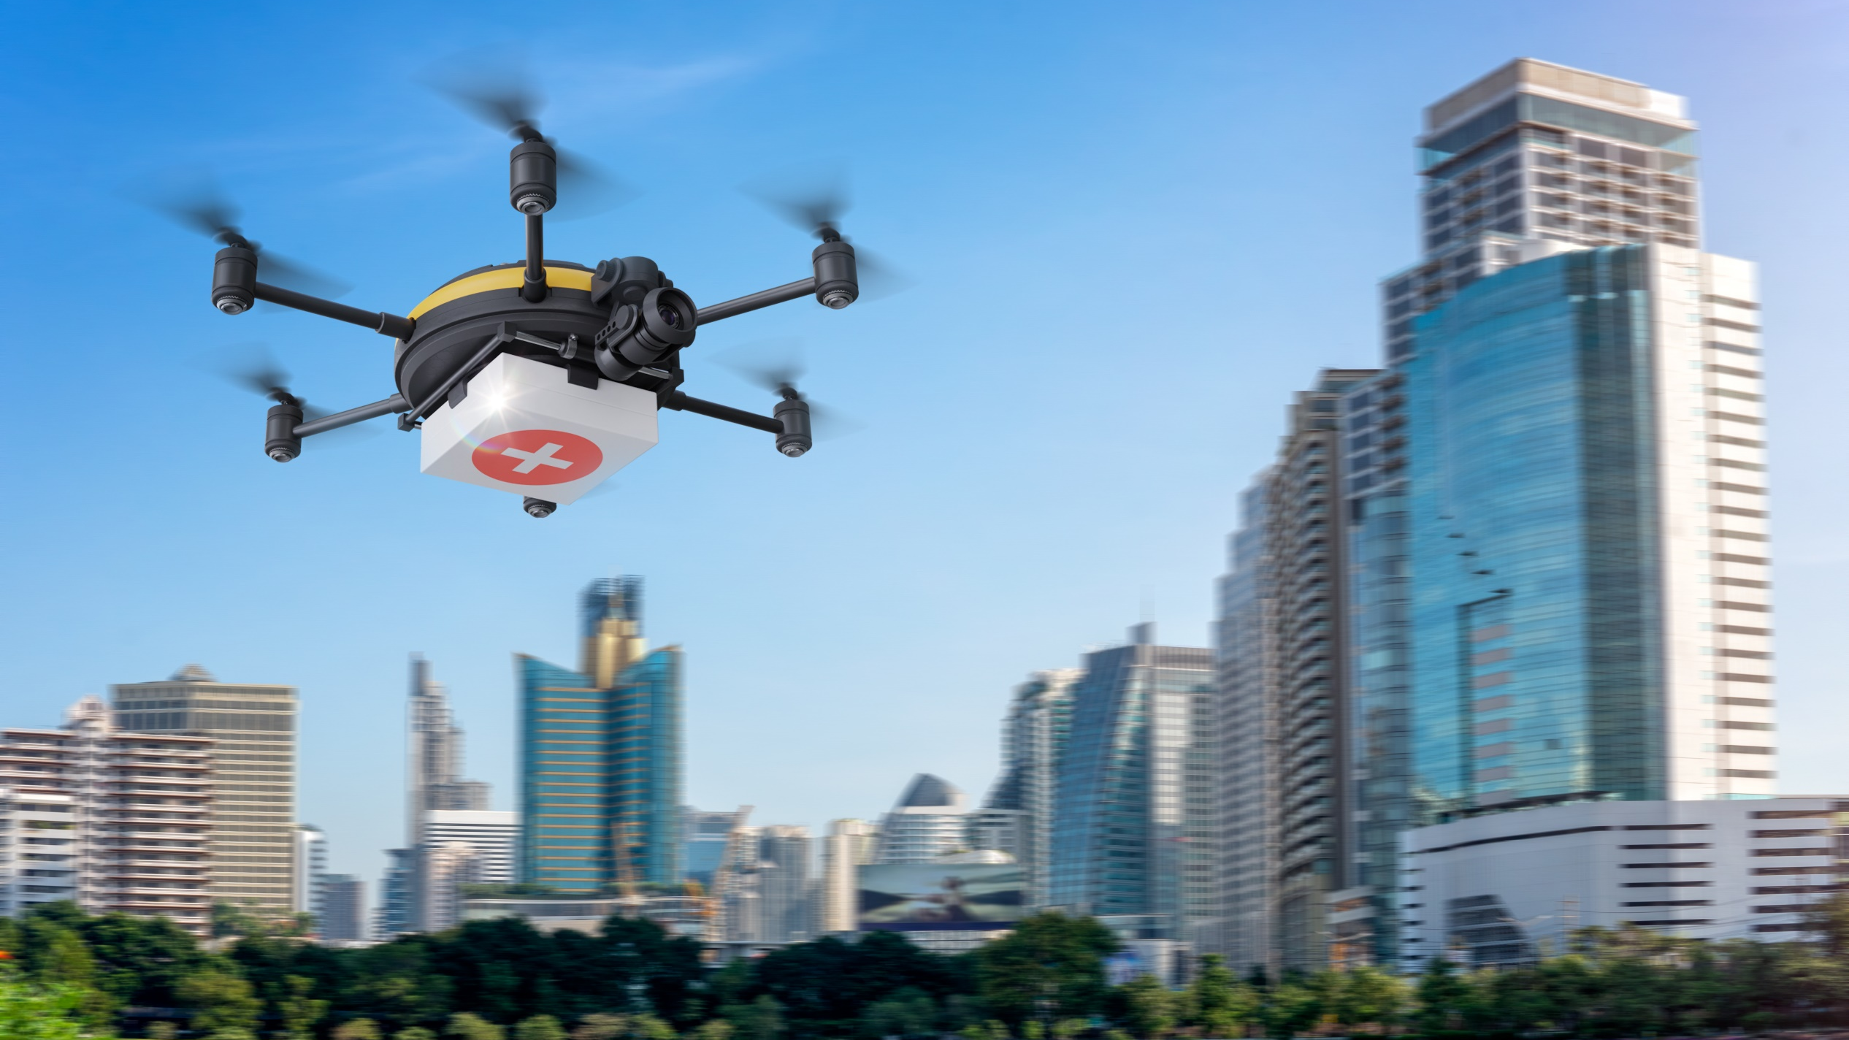
Logistics
This Use Case will test drone delivery capabilities as a fast and reliable method for transporting equipment, drugs or blood samples inside a large hospital territory.

Slide 11
Logistics
This Use Case will ease the deployment of an autonomous communication system by a fleet of drones in hard-to access areas.

Slide 12
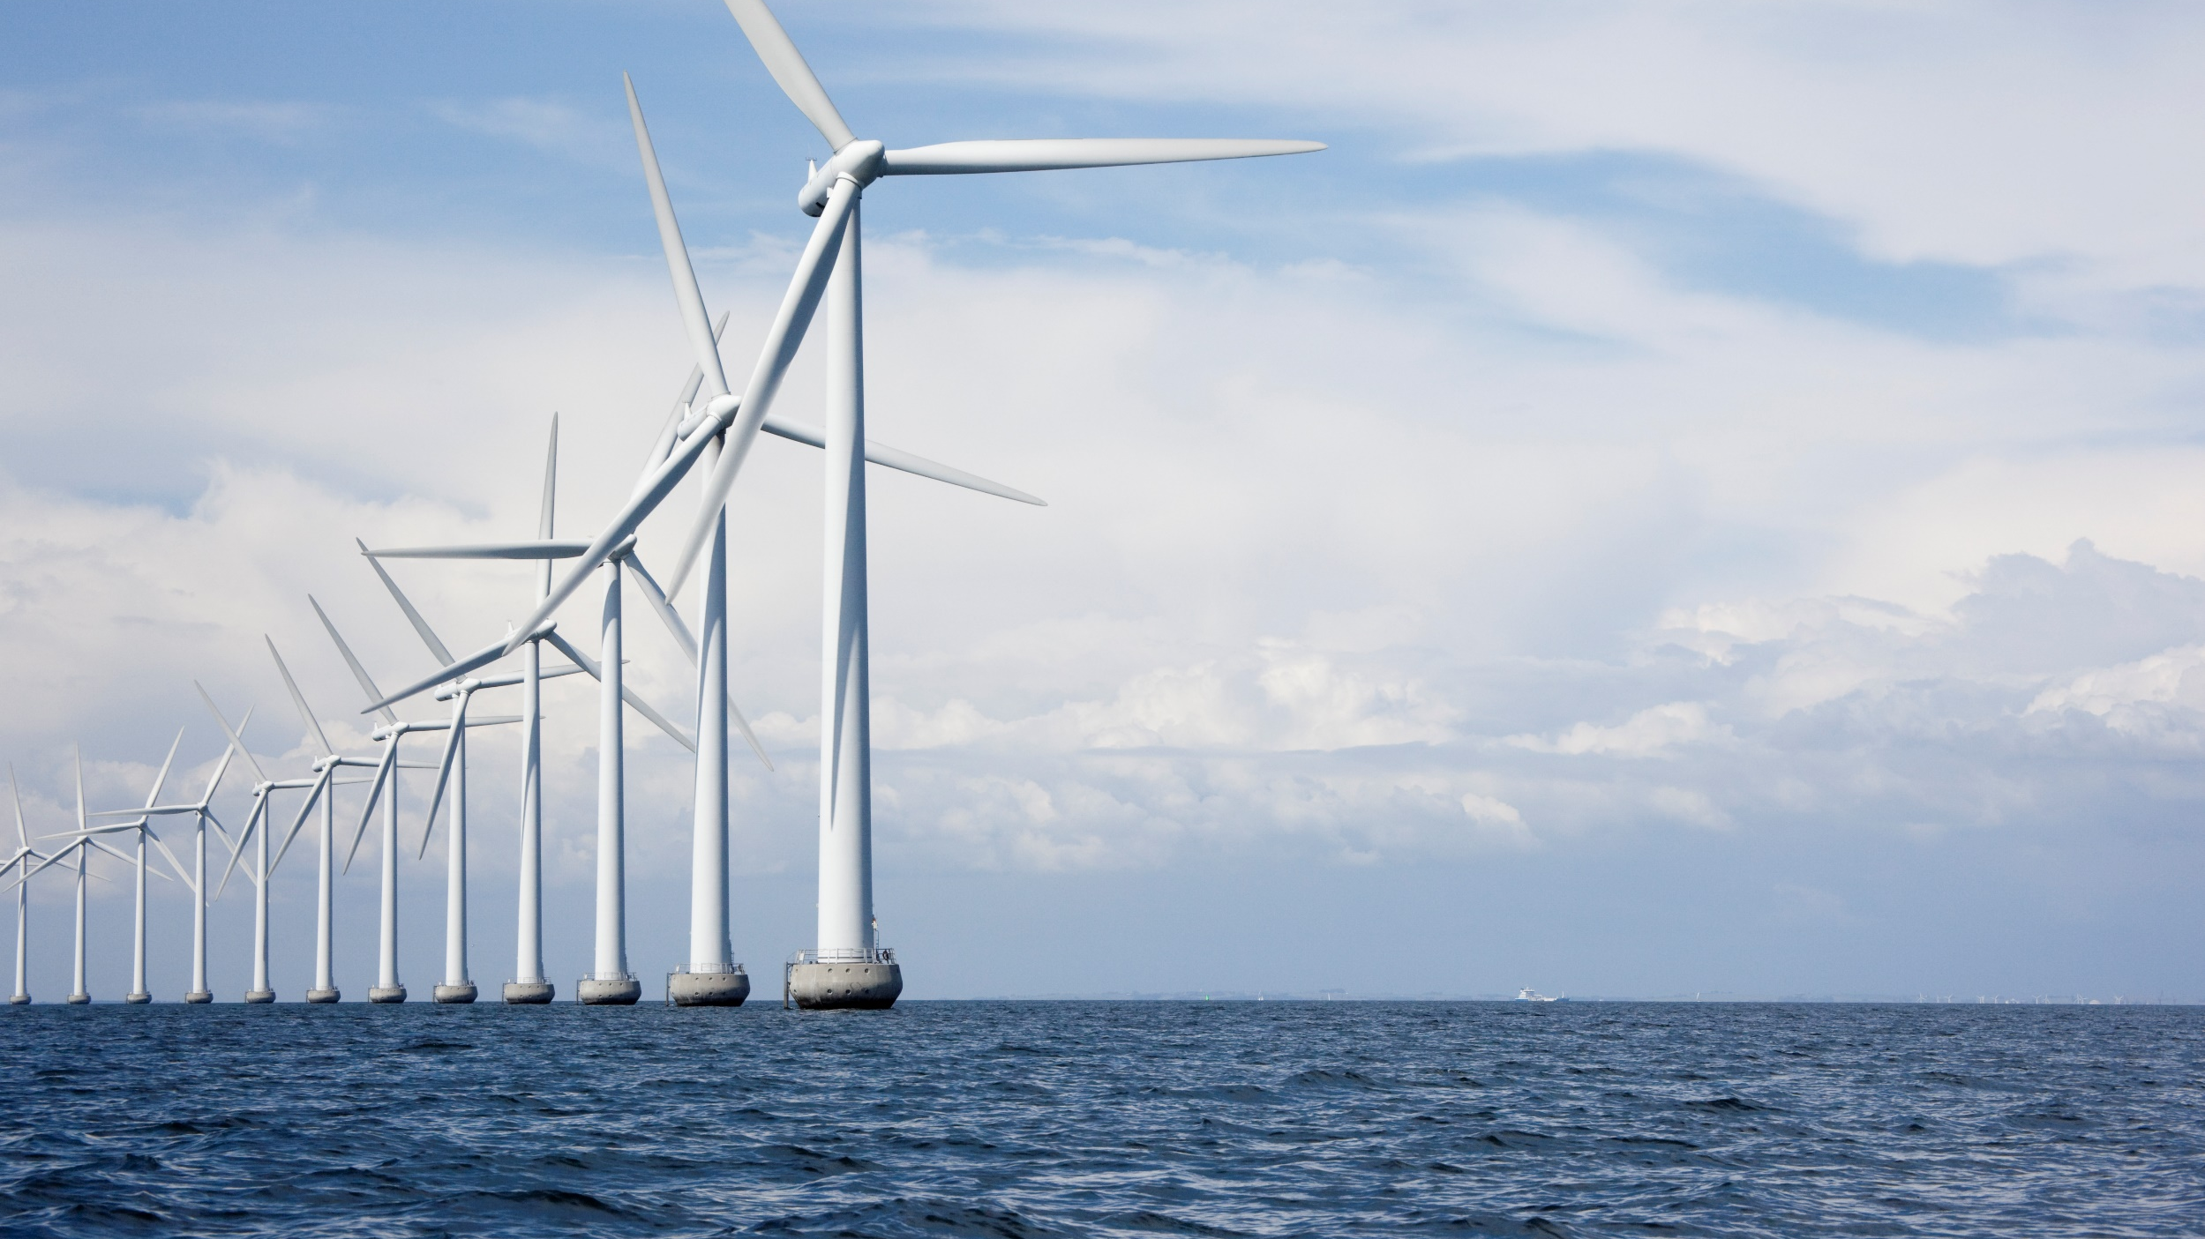
Surveillance and Inspection
The goal of this Use Case is to showcase the benefit of hyperspectral cameras on unmanned aerial vehicles for inspection of off-shore infrastructures.
This Use Case will also demonstrate the benefit of a fleet of drones and a land robot for mapping a disaster site.

Slide 13
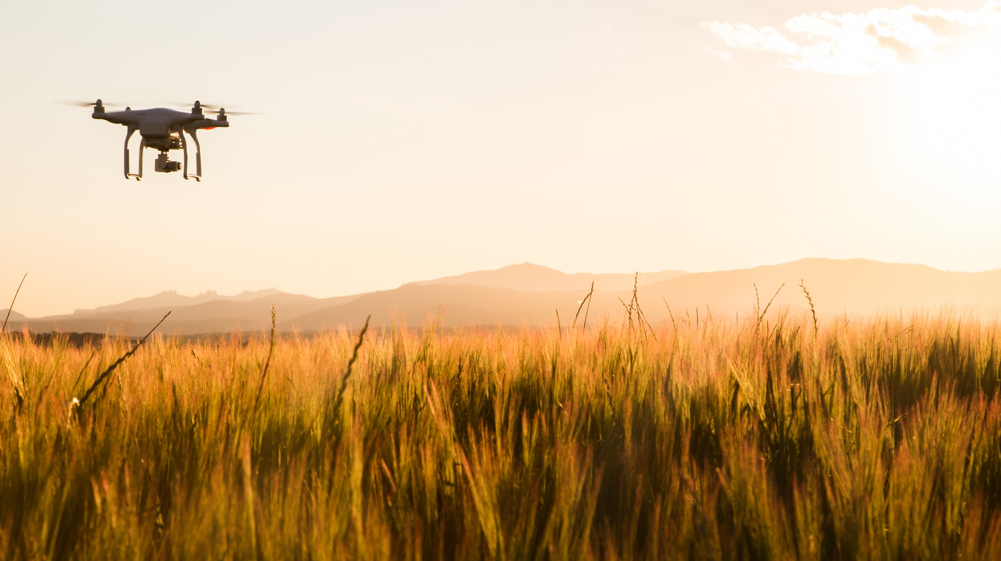
Agriculture
This Use Case will focus on technology needs for crop monitoring, focusing on crop health and growth management, and technology needs of wine cultivation.

Slide 15
